Slide 1
INB380 Game Project Lecture 1 Unit Outline
Ross Brown

Slide 2
Lecture Contents
Unit Preamble
Motivation and Aims
Outcomes
Processes
Assessments
Subversion Repository

Slide 3
Game Project
“The whole order of nature evinces a progressive march towards a higher life” - H. P. Blavatsky

Slide 4
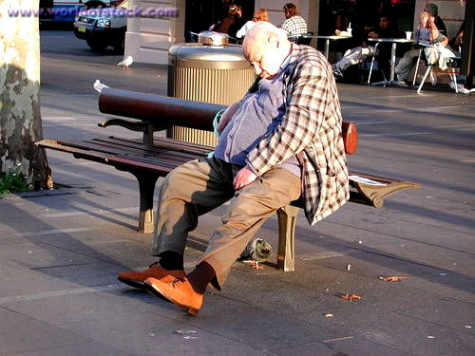
INB380 Game Project Design Motivation
You have completed the INB379 component of this year long project
INB379 sought to simulate a pre-production process within a small games studio
INB380 will now simulate a production process within a small games studio
More intense than a lot of project approaches followed – see right

Slide 5

Aim: “The INB380 Experience”
Main Aim: give you an experiential template for indie game development
Exploration is deprecated
More on prioritisation of tasks
Emphasise polishing of content
Process oriented and convergent in nature
KEY OUTPUT is a published polished game

Slide 6
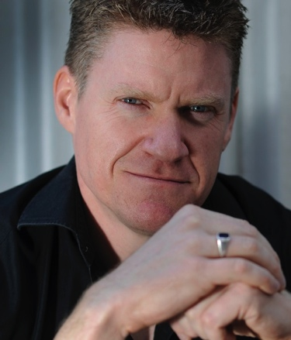
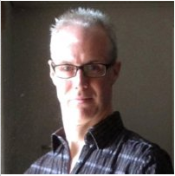
Your Teaching Team
Ross Brown – Unit Coord
25 years of tertiary teaching and research
3D computer graphics/virtual worlds SE expert
Unit coordinator of INB380 for seven years
Matt Ford – Industry Tutor
20 years of games industry experience at Microsoft, Auran, and Indie
High school teaching and BGIE tutoring/lecturer background
Owner and director of SwipeAds startup

Slide 7
Critique Meetings
Similar to INB379 - less about exploring options
More about making choices about what goes in the game for publication
More about responding to feedback from users
Will expect weekly test results in Beta testing stage

Slide 8
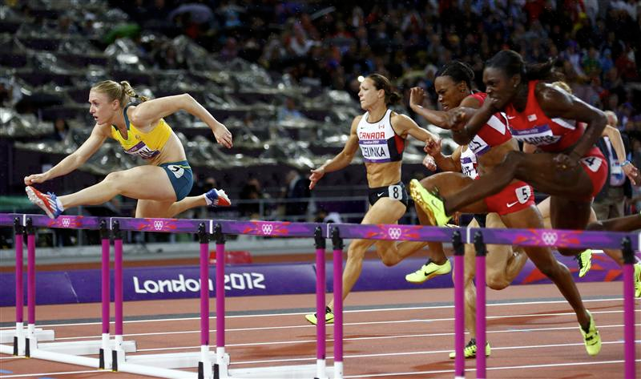
Unit Process and Outcomes
INB380 Games Project will be the Production phase
Three main tasks/milestones:
Alpha Phase – Week 1 -> Week 5
Beta Testing – Week 5 -> Week 9
Release Candidate Publishing – Week 10 -> Week 13
Follow this process and you will do well

Slide 9
Pre-alpha
Pre-alpha has been developed in INB379
Concepts have been explored
Game prototype tested and functioning, and is fun
NEED team tool chain for artists to build game
Concept level content developed with some final artifacts ready
You should know how to build the game
NB: This list will be evaluated in first critique

Slide 10
Alpha Phase Deliverable due Week 5
Develop the functionally complete Alpha by week five - NOT the final game
But must have a version that contains final major components/content/levels/mechanics
Do internal team testing
Alpha should not crash – much ☺
Ready for Beta testing in next phase
Need to think hard about WHAT goes in the game

Slide 11
Beta Phase Deliverable due Week 9
Test the Alpha thoroughly with your user base – you MUST test outside your team
Record the results in your online process log and present each week
Prioritise issues and fix them
NB: you cannot not fix everything, prioritise the issues – log this in the process documents

Slide 12
Publishing Phase Deliverable due Week 13
In this phase you setup your Website to download an installable version of the game
Setting up the installable version of the game is non-trivial, so it needs time
Create a marketing campaign to increase exposure – Facebook, Twitter, Sumea, IndieDB, Google Analytics
And so on

Slide 13
Final Deliverables
Finished Game – easily installable on target hardware – Clean GPS515 Alien or Android
Website – to market and deliver your game
Final Presentation – Week 14

Slide 14
Assessment
Project Process – 40% Week 13
Project Deliverables – 60% Week 13 & 14
Published Game – Week 13
Project Presentation – Week 14
I will now show you the CRAs – please get familiar with them

Slide 15
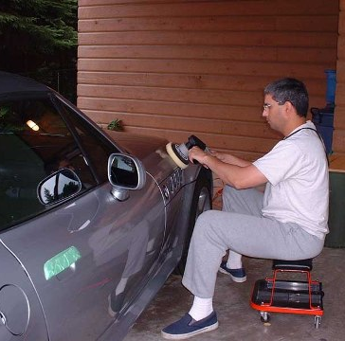
Polish
Polish is the theme for the unit
INB379 was about testing good ideas
INB380 is about polished games
You have to have a master craftsperson/maker attitude

Slide 16
World Class Work
That is, the highest grade can walk into a postgraduate course anywhere in the world
Is world class student work
Outcomes based – just like industry
If you do what we tell you, you get a 4-5
If you exceed what we tell you, then you get 6-7

Slide 17
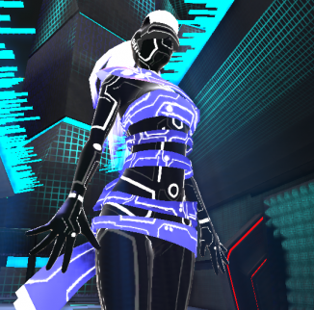
QUT World Class – 2010 SPAI Game
//No Comment winners of the IndieDB best UDK game 2010!
Presented to Epic Games in US
Then presented at US East Coast Games Conference

Slide 18
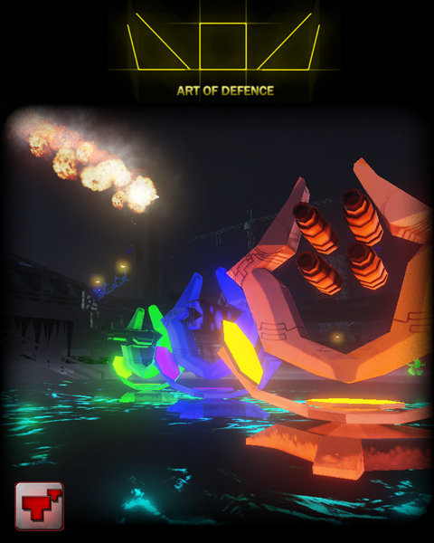
QUT World Class – 2011
Stranded and Awien Ambush making the top ten on IndieDB
NB: Minecraft is the top game on IndieDB
Manastorm made top fifty on Youtube Australia

Slide 19

QUT World Class – 2012
Applied Science, Torak, Crank and others made top ten Indie DB and featured on banner
Right Pedal games invited Illuminarty, Inertial Bash and Robot Misfits to pitch

Slide 20
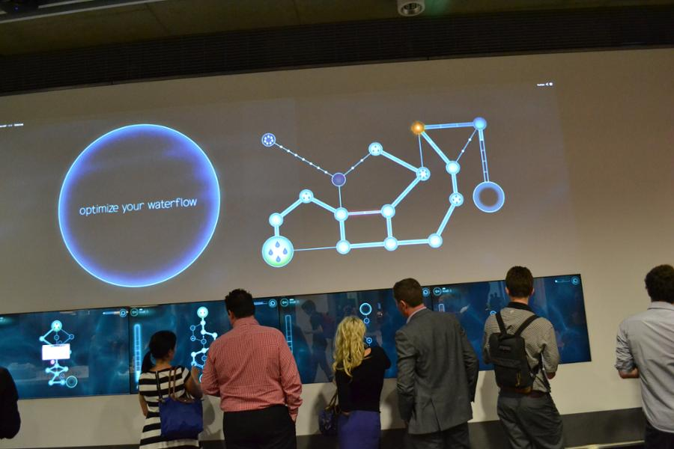
QUT World Class – Pressurizer 2013
Best executed game we have seen
Best team practices
Productive – many levels
Well Managed – they tracked their backlog burn down
Appropriate Risk – managed to get it onto the Cube

Slide 21
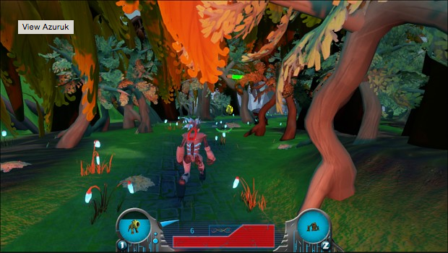
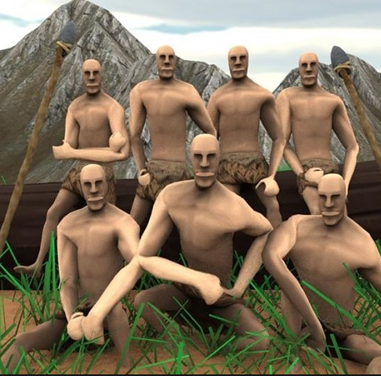
World Class - 2014
Azuruk – visually beautiful game
Primitives – great uptake by social networks – 1,200 followers in ~2 weeks, briefly 2nd place on IndieDB

Slide 22
Conscientiousness!
See: Higgins, D.M.; Peterson, J.B.; Lee, A.; Pihl, R.O. (2007). "Prefrontal cognitive ability, intelligence, Big Five personality and the prediction of advanced academic and workplace performance". Journal of Personality and Social Psychology 93: 298–319. doi:10.1037/0022-3514.93.2.298.

Slide 23
Previous INB380 Work - 2010
www.eternalduskgame.com
www.rockinmoses.com/cloud9
www.pineapplefishstudios.com/
www.elementalistgame.com/
www.indiedb.com/games/bear-story
www.badsciencegame.com/index.html
www.indiedb.com/games/spai
sites.google.com/site/fungiochi2010/home
www.kungfuteachergame.com/
www.noahsjungle.com/
www.indiedb.com/games/slipstream

Slide 24
Previous INB380 Work - 2011
www.indiedb.com/games/manastorm-lust-for-guts
www.indiedb.com/games/awien-ambush
www.indiedb.com/games/art-of-defence
www.indiedb.com/games/schools-out
www.indiedb.com/games/stranded
www.indiedb.com/games/synergy
www.indiedb.com/games/abzorb
www.indiedb.com/games/scrapped
www.indiedb.com/games/stick-ninja
www.indiedb.com/games/spectrum
www.indiedb.com/games/morvennan
www.indiedb.com/games/unleashed
www.indiedb.com/members/hover-game

Slide 25
Previous INB380 Work 2012
http://www.indiedb.com/games/crank
http://www.indiedb.com/games/applied-science
http://www.indiedb.com/games/robot-misfits
http://www.indiedb.com/games/torak
http://www.indiedb.com/games/illuminarty
http://www.indiedb.com/games/time-slash-clash-of-eras
http://www.indiedb.com/games/inertial-bash
http://www.indiedb.com/games/atomic
http://www.indiedb.com/games/catalyst
http://www.indiedb.com/games/rotation-fixation
http://www.indiedb.com/games/abnormals
http://www.indiedb.com/games/charnel
http://www.indiedb.com/games/quantum-leap
http://www.indiedb.com/games/tiki-toki-toy-machine

Slide 26
Previous INB380 Work 2013
http://pressurizergame.com/
https://play.google.com/store/apps/details?id=com.horizonproductions.audionaut&hl=en
https://play.google.com/store/apps/details?id=com.DropSoft.Droppit&hl=en
http://www.indiedb.com/games/demons-gear
http://www.indiedb.com/games/monokrome
http://2dtap.com/
http://www.indiedb.com/members/slanted-canteloupe
http://www.indiedb.com/company/armed-amoeba-studios
http://www.indiedb.com/games/once-i-was-blind

Slide 27
Previous INB380 Work 2014
Pirates vs Robots - http://www.indiedb.com/games/pirates-vs-robots/downloads
2199 - http://www.indiedb.com/games/2199-new-world-order/downloads/2199-new-world-order-beta-111
Azuruk - http://www.indiedb.com/games/azuruk/downloads/azuruk-11
Robot Wars - http://www.indiedb.com/games/robotwars/downloads
Treasure Raid - http://www.indiedb.com/games/treasure-raid/downloads
Symphony Quest - http://symphonyquest.com/
Primitives - http://www.indiedb.com/games/primitives/downloads

Slide 28
Lectures – Pointers for the unit
Lecture 1 – Unit Processes
Lecture 2 – Agile methods and SVN workshop
Lecture 5 – User Testing
Lecture 9 – Game Publishing
Each week will have a briefing lecture for 20 minutes at 10:00am Tuesdays
will not be recorded
will not be repeated
ask lots of questions

Slide 29
Critique Meetings – Week 1 Onwards
Weekly presentations in Game Development Studio
EVERYBODY - ready with video, game build, process document etc.
Panels have Industry member and academic
Matt Ford experienced games professional
Team critiques are 30 minutes each
Process mark on iPad via shared SS, amount and effectiveness of work done
Begin to work towards Week 5 Alpha delivery NOW!
BTW - trust us, we know what we are doing ☺

Slide 30
A word to the small amount of lazy people
Most of you will work hard, and engage with the process of developing a great game
Meetings are compulsory - lack of attendance is a probable cause for failing the unit as you have to show you have done the work
We will not be sympathetic if attendance is poor
Subversion log and process document will show your work each week – so no hiding
Sustained effort will bring a better design – we aim for high standards

Slide 31
Hall of Shame
If you want to annoy us, say the following:
“I got no work done because I spent the week playing GTA5” – you can all do the math
“I’m going for three weeks to Thailand” – this was after the student abused another for not working!
“I was at a Bronies convention” – I’ll leave you to guess our response
“I spent three weeks sailing” – there is only one response to this, but I won’t repeat it here
“I dunna” – hmmm
Hard work will bring encouragement, otherwise we will be blunt in our assessment

Slide 32
Some Practical Issues
Subversion (SVN) repositories are available
Use of some collaborative tools is enforced this semester – Google Calendar, Process Document and Source Control
Keep personal backups as well – subversion deleted next semester
Unit subversion server for lectures, assessment CRAs etc is found at:
www.theblacksphere.com/INB380

Slide 33

SVN Log
Shows timestamps of work done
Stops people slacking and avoiding failure
However, need meaningful commit statements
Everybody contributes – artists, producers, programmers, animators etc.
MAKE SURE you setup properly with Unity!
Here for Instructions
If you have slow links, interleave screen grabs with major uploads at QUT
GITS can be used - Must send me an email with an image using Tortoise GIT with graph of update stats before I am happy

Slide 34
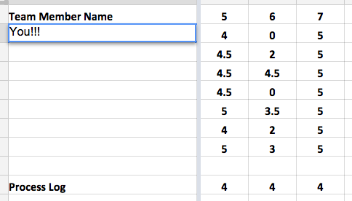
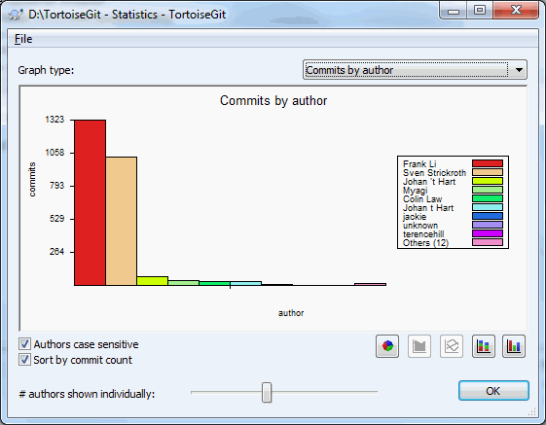
Big Brother is Watching You! Process SS and Source Repos
This may also stop you failing the unit, as happened in 2012 with one team
Stops a team having to dob anyone in for being lazy
Weeks missed are lost -> you cannot make up the grades over the semester
Repo usage at end of semester marked – everybody uses a repo!

Slide 35
Producer’s Weekly Process Document
Mandatory Weekly report for team to be submitted as one page document
Salient points summarising week
Template on right
Insert anything else to communicate a point
Will be marked along with meeting process each week from 0-5
We expect 16-20 hours per week on this unit, from each person in the team minimum
Title: Week # Report
Summary/Reflection
Achievements:
Jobs 1, 2, 3 etc.
Problems:
Probs 1, 2, 3 etc.
Plans:
Plan 1, 2, 3 etc.

Slide 36
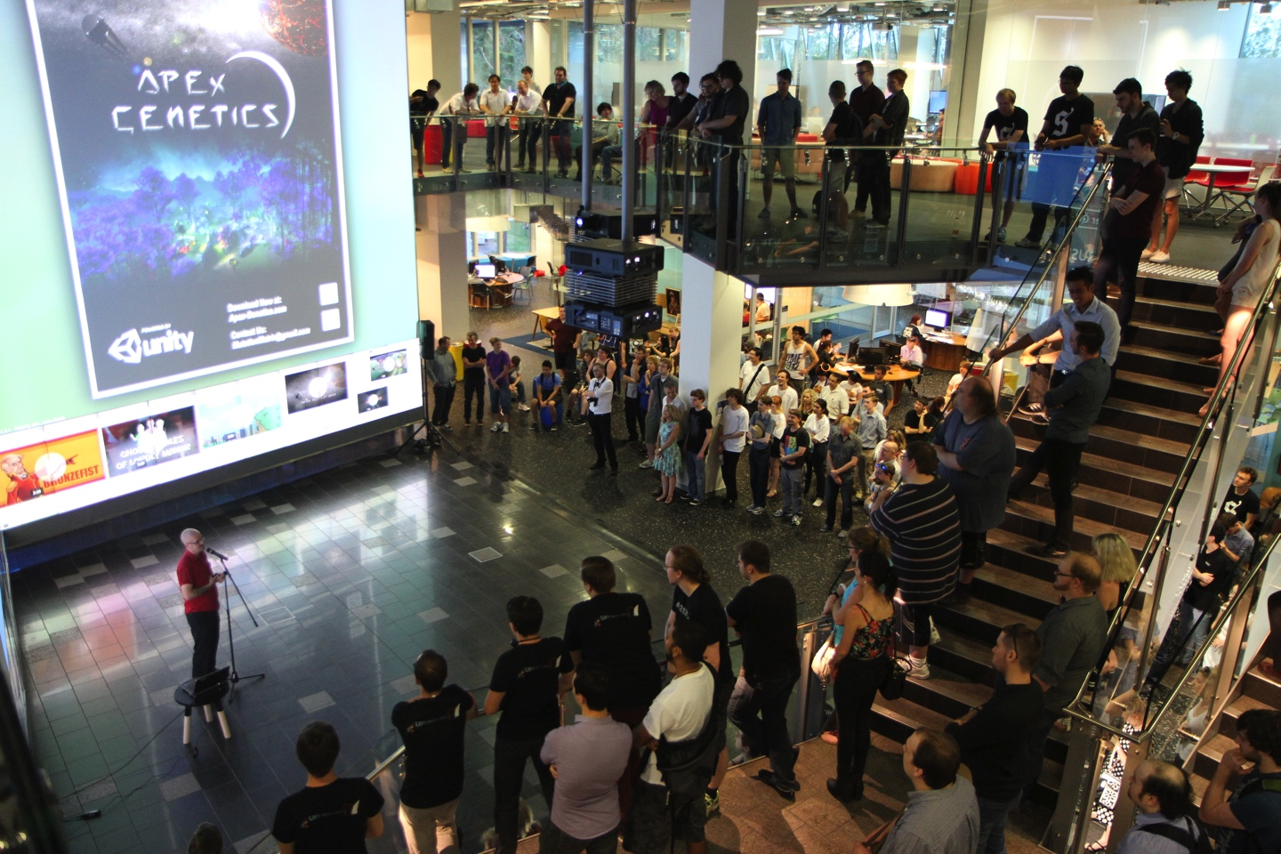
Down to Business!
We have an end of year industry day
Those with a five and above can exhibit
Will be in the Cube with some “special guests”
Note Right Pedal Games are looking to fund startups - twitter.com/RightPedalNews – Subscribe!!!
Anthony Wood – BGIE 2010 now has his own Screwtape Studios at Right Pedal -

Slide 37
Subversion Servers
Next week we will have a workshop on using svn repos, planning and Agile methodologies
Look on the INB380 svn to get the workshops – Mac and Win 7
Tortoise (Installed in Studio) – www.tortoisesvn.net
Aim will be to show major commands etc.
Free O’Reilly SVN guide is on unit svn – www.theblacksphere.com/INB380
QUT SVNs are not mandatory, but I must have an account on your repository

Slide 38
Week 1 Critique Briefing
Show us the status of the game in GPS515, wrt the list we sent you via email
Will be evaluated via that checklist

Slide 39
Week 2 Heads Up – Deliverables Project Plan and Tools
Google Calendar of weekly tasks and milestones
Links to weekly process document – Google Docs prescribed
Subversion server setup – mandated for whole team
I will run a workshop in the next lecture to go through Tortoise and SVN issues in some detail
Lecture on Agile development approaches and project management, and workshop on SVN

